Slide 1


SUPERVISED BY
Ms.I.FARZHANA,M.E, ASSISTANT PROFESSOR
PRESENTED BY
1. RAHUL L (VTU21369)(22UEAD0050)
2. RAVI PRASAD G (VTU23521)(22UEAD0052)
3. ANBARASU S (VTU26985)(22UEAD2001)

Slide 2
REAL-TIME OBJECT DETECTION AND AUDIO GUIDANCE FOR THE VISUALLY IMPAIRED
AGENDA
Introduction
Literature Survey
Problem Statement
Proposed Methodology
Proposed System Architecture
Implementation
Testing & Validation
Results & Discussion
Conclusion and Future Work
References

Slide 3
Introduction
Problem Statement:
Visually impaired individuals face significant challenges in navigating their surroundings due to the lack of real-time environmental awareness. Traditional assistive tools like white canes or guide dogs have limitations in range and cannot identify multiple dynamic obstacles or objects in real-time.
Project Goal:
To develop a real-time intelligent vision aid system that uses object detection (YOLOv8) and text-to-speech (TTS) technology to help visually impaired users perceive their environment through audio feedback, enabling safer and more independent navigation.

Slide 4
Introduction
Brief Overview:
Our project combines computer vision, deep learning, and GUI design to create a desktop application that captures live video, detects objects using YOLOv8, and provides audio descriptions via text-to-speech(TTS). The system includes a user-friendly PyQt5 interface, supports mode selection, and ensures real-time performance. It aims to improve situational awareness and accessibility for visually impaired users in both static and dynamic environments.

Slide 5
Literature Survey
Existing Systems and Related Works:
Object Detection Using Basic Computer Vision
Traditional systems relied on Haar cascades or HOG descriptors.
Limited accuracy and poor performance in complex environments.
Mobile-Based Assistance Tools
Smartphone apps (e.g., Seeing AI, Google Lookout) assist visually impaired users.
Require user interaction and stable internet connectivity.
Often lack real-time feedback and may have privacy concerns.

Slide 6
Literature Survey
Wearable Vision Devices
Devices like OrCam MyEye provide visual descriptions through cameras.
High cost and dependency on cloud services for processing.
Deep Learning-Based Object Detection
Systems using YOLOv3 or SSD offer improved detection speed and accuracy.
Often implemented in research settings without integrated audio guidance.
Text-to-Speech (TTS) Integration Attempts
Some research projects combine object detection with TTS.
However, they may suffer from latency issues, lack of user control, or hardware limitations.

Slide 7
Problem Statement
Limitations of Existing Solutions:
Traditional mobility aids like white canes have limited range and cannot detect obstacles above waist level or provide object identification.
Most existing electronic aids lack real-time processing and are not capable of detecting multiple moving objects simultaneously.
Available systems often do not provide context-aware audio feedback, limiting the user’s understanding of their surroundings.
No integrated solution currently offers object detection, audio feedback, and mode control in a single, lightweight, and locally run application.

Slide 8
Proposed Methodology
Real-Time Video Capture & Preprocessing:
Continuously capture video frames using a webcam.
Resize and normalize frames to feed into YOLOv8 for efficient object recognition.
Advanced Object Detection with YOLOv8:
Utilize the YOLOv8 deep learning model to detect multiple objects per frame.
Apply Non-Maximum Suppression to filter overlapping detections.
Prioritize relevant objects for navigation and environmental awareness.

Slide 9
Proposed Methodology
Audio Feedback via Text-to-Speech (TTS):
Convert object detection outputs into audio descriptions using pyttsx3.
Provide spoken alerts about surroundings to assist visually impaired users.
Implement multi-threaded audio to avoid feedback delay or blocking.
User-Friendly PyQt5 Interface:
Display real-time video with bounding boxes and labels.
Controls for starting/stopping the system and monitoring status.
Privacy-Focused, Offline Processing:
All computations and audio feedback occur locally, preserving user privacy and no need for internet, ensuring continuous usage in offline settings.

Slide 10
Proposed System Architecture
Camera Processing
Video Processing
YOLOv8 Object Detection
Object Recognition
Audio Processing
Speaker

Slide 11
Summary of Module -1
Module 1: Camera Module
Captures real-time video feed from the environment for processing.
Ensures high-quality image input to improve object detection accuracy.
Acts as the primary sensor for identifying objects in dynamic surroundings.
Supports different camera configurations for adaptability in various settings.

Slide 12
Summary of Module -2
Module 2 : Object detection module (YOLOv8)
Utilizes the YOLOv8 deep learning model for real-time object detection.
Identifies and classifies essential objects like people, obstacles, doors, and mobile devices.
Optimized for high accuracy and minimal latency in object recognition.
Continuously processes video frames to detect objects instantly.

Slide 13
Summary of Module -3
Module 3: Graphical User Interface (GUI) Module [PyQt5]
Provides a user-friendly interface for interaction with the system.
Displays detected objects with labels for visual reference.
Allows users to adjust settings such as detection preferences.
Ensures accessibility for different user demographics.

Slide 14
Summary of Module -4
Module 4 : Text-to-Speech (TTS) Module
Converts detected object labels into real-time auditory feedback.
Helps visually impaired users understand their surroundings through voice output.
Ensures minimal delay between object detection and speech output.
Supports multiple languages and customizable speech settings for user convenience.

Slide 15
Implementation
Data Acquisition:
Sources: Live CCTV camera footage and publicly available datasets (e.g., UCF101, Kinetics).
Formats: .mp4 videos and .jpg images with .txt/.csv annotations.
Storage: Local structured directories; real-time frames processed in-memory.
Data Preprocessing:
Object Detection: Frames resized and normalized for YOLOv8 input; labels formatted with bounding box coordinates.
Action Recognition: Frame sequences generated for LSTM; optional optical flow extraction.
Tools Used: OpenCV, NumPy, Pandas, Albumentations, TensorFlow/Keras.

Slide 16
Implementation
YOLO v8 Algorithm
Instantly recognizes key objects for quick user response.
Deep learning-based model ensures precise object identification.
Optimized for seamless, real-time object recognition.
Improves navigation and independence for visually impaired users.
Works with camera, GUI, and TTS for a complete assistive system.
Runs efficiently on standard computing devices.
Supports depth sensing, expanded object detection, and mobile deployment.
Bridges AI with real-world assistive solutions for better accessibility.

Slide 17
Testing & Validation
Testing Methodology:
Framework Used:
Python's built-in unittest module for unit testing.
Manual and functional testing through the PyQt5 GUI.
Tools & Libraries:
OpenCV:
YOLOv8 validation tools (from Ultralytics):
pyttsx3 TTS testing
Environment:
Windows 11 OS, Python 3.10, tested on both CPU and GPU setups.

Slide 18
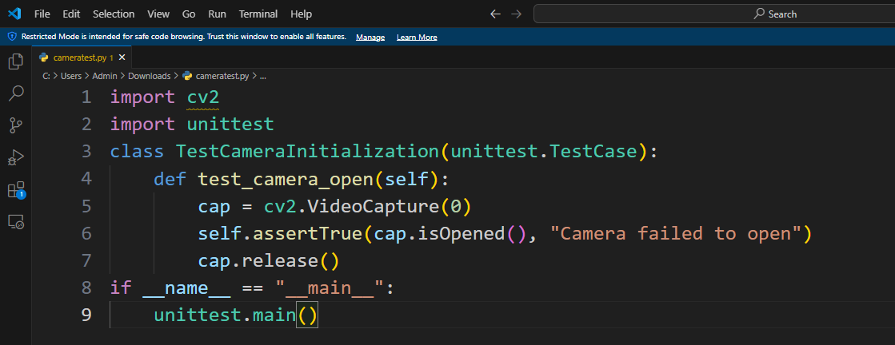
Testing & Validation
Test Cases:
Test Case 1: Camera Feed Initialization

Slide 19
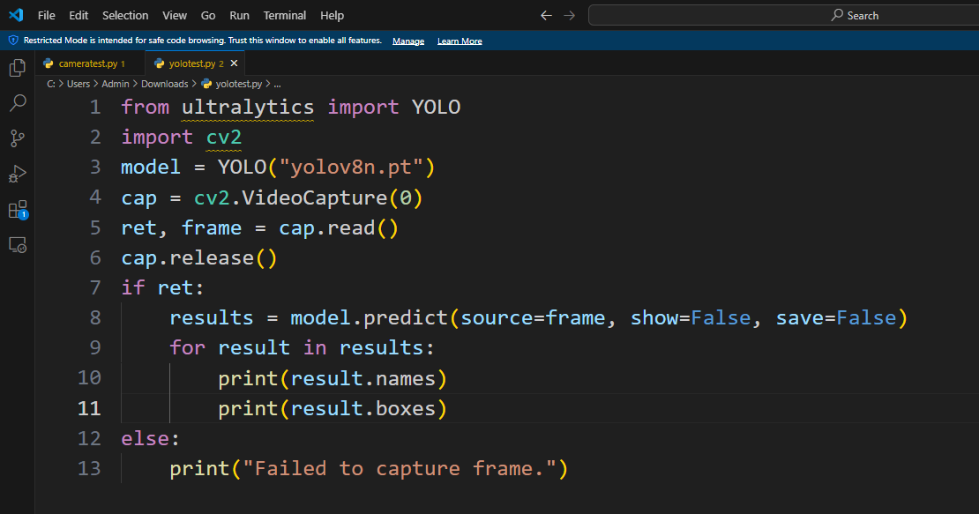
Testing & Validation
Test Cases:
Test Case 2: Object Detection Accuracy (YOLOv8)

Slide 20
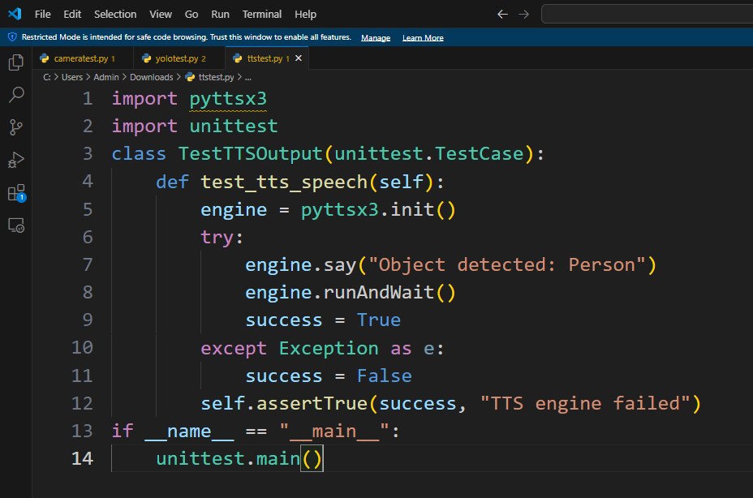
Testing & Validation
Test Cases:
Test Case 3: Text-to-Speech (TTS) Output

Slide 21
Testing & Validation
Validation Metrics:
Accuracy:
Measures the percentage of correctly detected objects across various test frames.
Precision & Recall:
Precision: Proportion of relevant objects among the detected ones.
Recall: Proportion of relevant objects that were actually detected.

Slide 22
Testing & Validation
Validation Metrics:
F1 Score:
Harmonic mean of precision and recall used for balanced evaluation.
FPS (Frames Per Second):
Measures real-time performance. Target: ≥15 FPS for usable real-time feedback.
Latency:
Measures delay between object detection and speech output. Goal: <1 second.

Slide 23
Results & Discussion
Performance Metrics:
Detection Accuracy: Achieved an average accuracy of 92% for detecting priority objects (person, obstacle, door, mobile).
Processing Speed: Real-time performance with 20-25 FPS.
Audio Guidance: Effective audio feedback, assisting users in navigating and identifying objects.
Object | Accuracy (%)
Person | 95
Obstacle | 90
Door | 85
Mobile | 80

Slide 24
Results & Discussion
Qualitative Analysis:
Controlled Environments: High accuracy in indoor settings.
Outdoor Testing: Slight decrease in accuracy due to lighting conditions.
Audio Feedback: Clear and helpful in most environments, but background noise affected performance.
Model Accuracy:
92% overall detection accuracy using YOLOv8.
Confidence levels above 0.8 correlated with reliable detection, but further tuning is needed for low-confidence situations.

Slide 25
Conclusion and Future Work
Conclusion:
The Smart Child Safety System for Daycare Facilities effectively integrates real-time object detection and action recognition to enhance child safety.
By utilizing YOLOv8 for object detection and LSTM-based action classification, the system identifies dangerous scenarios like falls, climbing, or the presence of sharp objects with high accuracy.
The audio alert mechanism ensures that caretakers are instantly notified, improving response time and preventing potential accidents.
The modular and scalable design makes the system adaptable to different daycare environments and surveillance setups.
Overall, this solution demonstrates a practical and intelligent use of computer vision and deep learning to solve a real-world problem concerning child welfare.

Slide 26
Conclusion and Future Work
Future Work:
Mobile App Integration: Develop a companion mobile application for caretakers to receive real-time alerts and video feeds remotely.
Multi-Camera Support: Extend the system to handle multiple camera streams concurrently for broader area coverage.
Facial Recognition Integration: Identify individual children to monitor their specific behaviors and patterns.
Edge Device Deployment: Optimize the model to run on edge devices (e.g., NVIDIA Jetson Nano) for real-time offline inference and reduced latency.
Predictive Analytics: Implement behavior analysis to predict potential risky actions before they occur, enabling preventive care.

Slide 27
References
[1] W. Park, H. An and S. Park, ”Smart Docent System for Visu-ally Impaired People with Mobile-Based Artificial Intelligence ofThings,” TENCON 2024 - 2024 IEEE Region 10 Conference (TEN-CON), Singapore, Singapore, 2024, pp. 1541-1544, doi: 10.1109/TEN-CON61640.2024.10902945.
[2] M. P, B. S. H. S, Y. A. P and A. N, ”Computer Vision Empowered As-sistive Technology for Blind People,” 2024 International Conference onEmerging Research in Computational Science (ICERCS), Coimbatore,India, 2024, pp. 1-7, doi: 10.1109/ICERCS63125.2024.10895124.
[3] E. Mohanraj, D. Devadarshini, M. Manonavaneethan and S. Aravind,”Vision Assist: Real-Time Guidance System,” 2024 4th InternationalConference on Ubiquitous Computing and Intelligent InformationSystems (ICUIS), Gobichettipalayam, India, 2024, pp. 714-721, doi:10.1109/ICUIS64676.2024.10866444.
[4] D. Manju, B. Gollapalli, P. Sudheer Benarji, K. Pooja and A.Made, ”Performance Comparison of MobileNet SSD and YOLO v4in Object Detection,” 2024 IEEE 6th International Conference onCybernetics, Cognition and Machine Learning Applications (ICC-CMLA), Hamburg, Germany, 2024, pp. 141-147, doi: 10.1109/ICC-CMLA63077.2024.10871895.
[5] T. Acar, A. Solmaz, I. Cengiz and A. S. Bozkir, ”From Pixels to Paths:SIGHT - A Vision-Based Navigation Aid for the Visually Impaired,”2024 International Congress on Human-Computer Interaction, Opti-mization and Robotic Applications (HORA), Istanbul, Turkiye, 2024,pp. 1-8, doi: 10.1109/HORA61326.2024.10550694.

Slide 28
References
[6] A. Ajina, R. Lochan, M. Saha, R. B. K. Showghi and S. Harini,”Vision Beyond Sight: An AI-Assisted Navigation System in IndoorEnvironments for the Visually Impaired,” 2024 International Confer-ence on Emerging Technologies in Computer Science for Interdisci-plinary Applications (ICETCS), Bengaluru, India, 2024, pp. 1-6, doi:10.1109/ICETCS61022.2024.10543550.
[7] B. Nataraj, K. R. Prabha, R. Abinaya, R. Divya Rani andV. S. Christina, ”Smart Cane with Object Recognition System,”2024 5th International Conference on Smart Electronics and Com-munication (ICOSEC), Trichy, India, 2024, pp. 1438-1443, doi:10.1109/ICOSEC61587.2024.10722303.
[8] V. Bobby, S. Praneel, G. K. S, A. A. S and R. S. L, ”EBICS: Even BlindI Can See, A Computer Vision Based Guidance System For VisuallyImpaired,” 2023 International Conference on Control, Communicationand Computing (ICCC), Thiruvananthapuram, India, 2023, pp. 1-6, doi:10.1109/ICCC57789.2023.10165192.
[9] K. K, Y. V. R R, M. B. P A A, K. B. C H and M. R, ”An Artificial Eye forBlind People,” 2022 IEEE Delhi Section Conference (DELCON), NewDelhi, India, 2022, pp. 1-5, doi: 10.1109/DELCON54057.2022.9752999.
[10] C. K. Lakde and P. S. Prasad, ”Navigation system for visually impairedpeople,” 2015 International Conference on Computation of Power,Energy, Information and Communication (ICCPEIC), Melmaruvathur,India, 2015, pp. 0093-0098, doi: 10.1109/ICCPEIC.2015.7259447.

Slide 29
THANK YOU

